Slide 1
RF – Eats: Food and Liquid Sensing in Practical Environments using RFID
CMSC818W: Introduction to IoT and Mobile Computing
Presented by:
Usama Younus, Arun Kumar
Slide Credits: Unsoo ha, Junshan Leng, Alaa Khaddaj, Fadel Adib

Slide 2
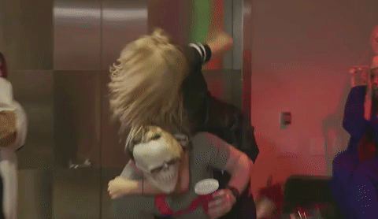



  Intended Outcome of a Product
Alcohol
This
Not This
Milk
Notes:
Our today’s presentation actually starts with a concept: the intended outcome of a food product in our mind, whenever we go for shopping[click]. In simple words, the use or benefit of that product
[click] For starters, lets take the example of Alcohol, when we go to buy it, we may have something of like this in mind - maybe after a lot of consumption but still a possible scenario[click]. However we would never think that it could have this sort of an impact [click].
Same is the scenario with milk [click]. When we buy it, we consider it for its nutritious value[click] but sometimes it can have its adverse affects [click]

Slide 3
  Intended Affect of a Product
This
Not This
Alcohol

Slide 4
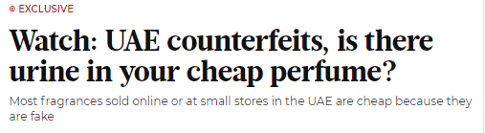

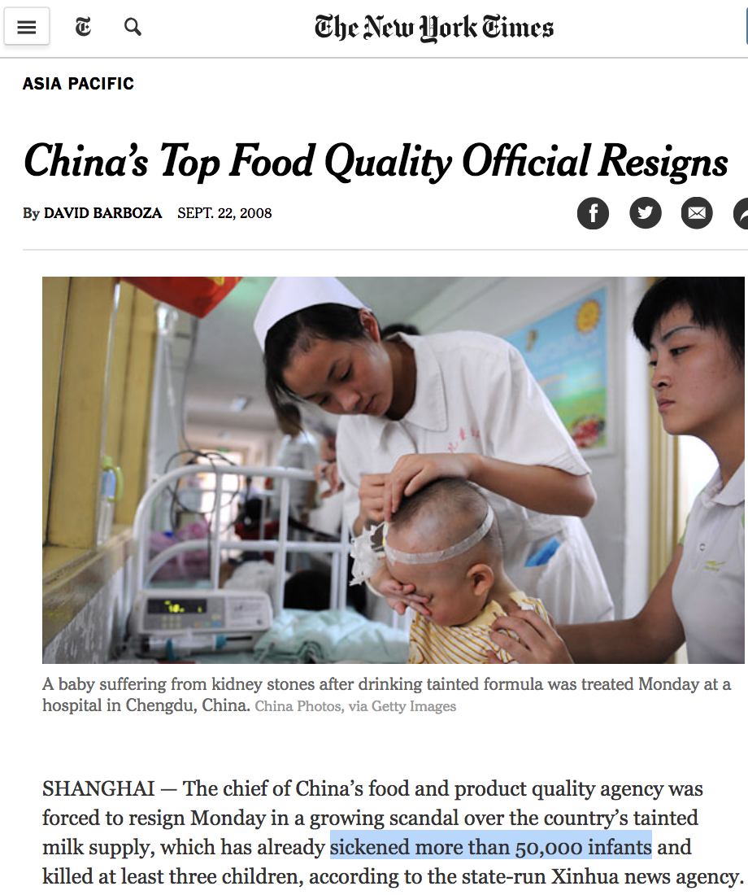
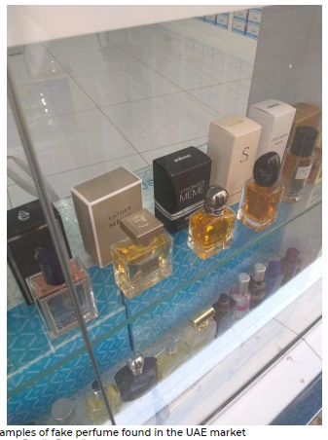
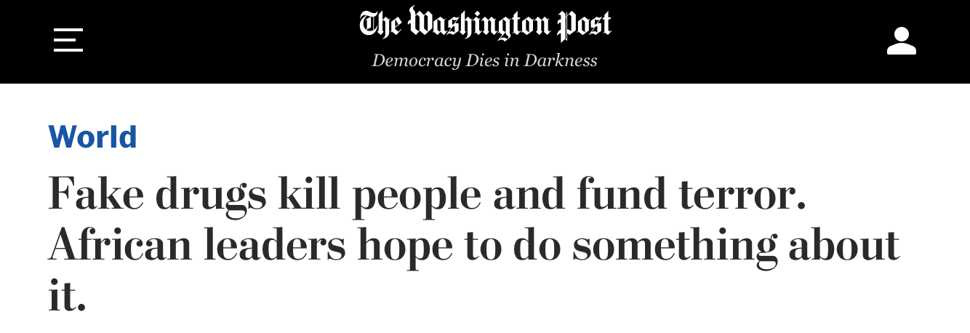
Impact Gone Wrong Globally
Notes:
[FASTER]
SO, you may be thinking right now, that these adverse outcomes are highly unlikely in general scenarios, but the evidence speaks to the contrary.
[click] Back in 2008, 50 thousand kids were hospitalized due to a fake baby milk formula gone viral
[click] same is the case with alcohol, there have been instances of people getting blind and even dying from counterfeit alcohols
[click] fake drugs is also one of the problems that kills many people
[click] and some malicious people have even not left perfumes as they are [click next slide]

Slide 5
  Approaches
Get the materials tested through a food quality lab
Measure properties of food and liquids in containers through food testing equipment ourselves
Develop a solution that may allow for contactless measurement of the item quality
Notes:
So, here comes a question, that how can we handle such fake items present in some of the markets.
There are multiple ways to approach this problem.
[click] Not a viable solution due to Scalability issues. We cannot send all items for testing
[click] Again these equipment are expensive and large, and requires contact with material. We cannot open all bottles in market to test what is in it
[click] Seems like a viable solution.

Slide 6
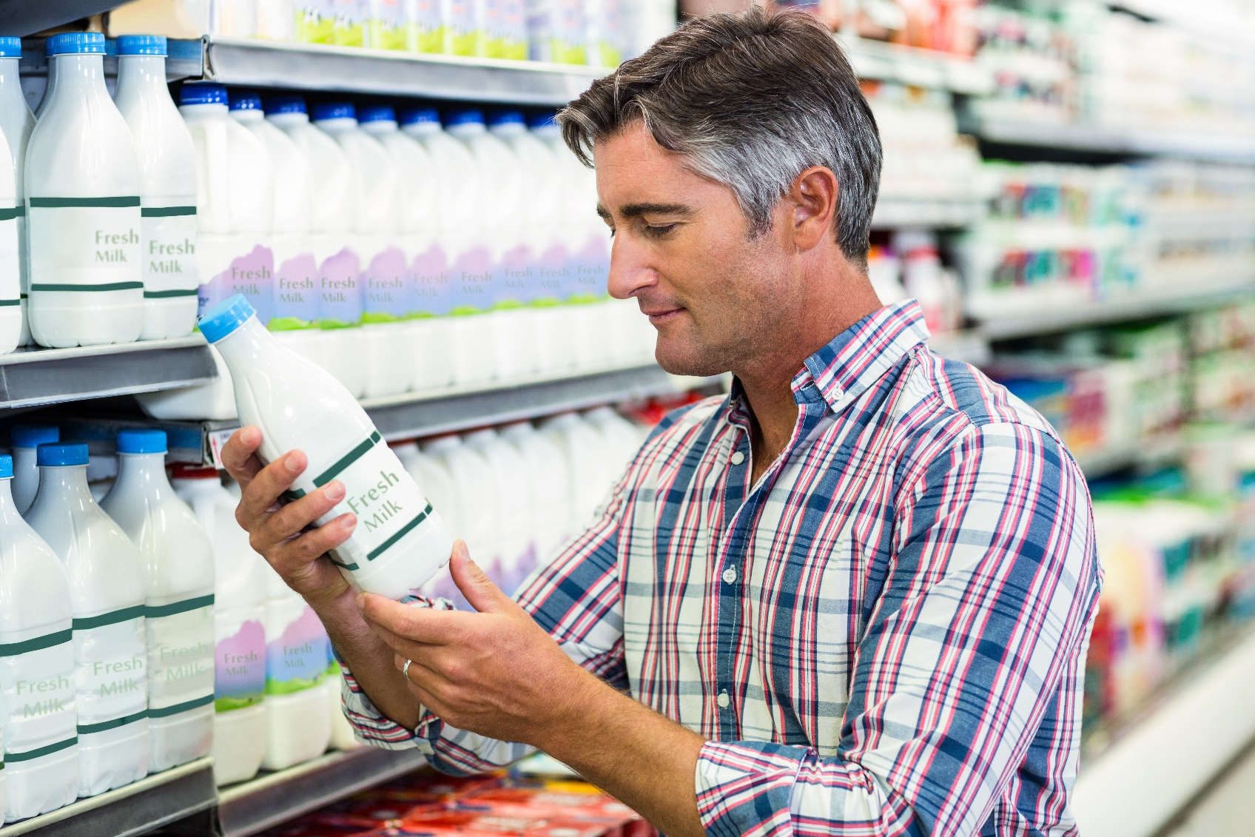
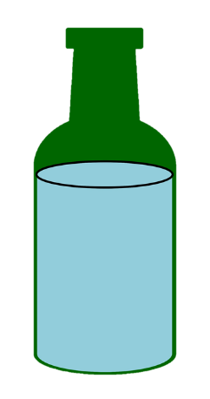


  Can we sense food and liquids in closed containers?
Is it safe?
Is it authentic?
Has it expired?
Notes:
So, now we have a new way of looking at things and an
unattended question as well: [click] Can we actually sense these properties in a closed container? [pause] This paper actually address the same question using a technology that is already present on most of these items - [click] RFID TAGs.
[click next slide]

Slide 7
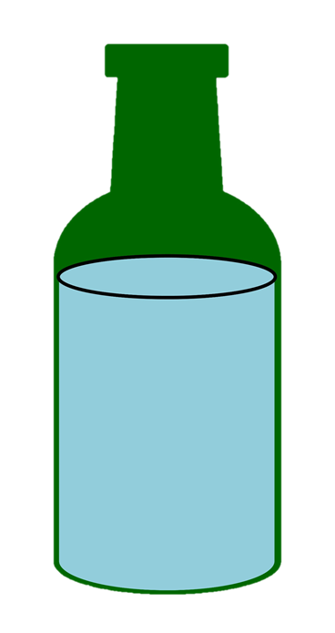

Approach: Exploit the wireless interaction between an RFID and the content
Notes:
So, the approach here is to exploit the wireless interaction between an RFID placed on a container and the content of that container
[click next slide]

Slide 8
Approach: Exploit the wireless interaction between an RFID and the content
Content
Air
ε
Dielectric
Constant
Near Field
Notes:
Even without being in direct contact with the content, the RFID will wirelessly interact with it. [click] This interaction is governed by a property of the content called the dielectric and denoted by epsilon.
[click next slide]

Slide 9
Approach: Exploit the wireless interaction between an RFID and the content
Content
Air
ε
Near Field
RFID reader
Notes:
So, because of this interaction, when the RFID tries to communicate, its wireless signal will be impacted by the content.
[click next slide]

Slide 10

Approach: Exploit the wireless interaction between an RFID and the content
RFID reader
Extract features and infer if the content is fake/authentic
Notes:
So, the paper designed an RFID reader that can extract features from the RFID’s signal and analyze them in order to determine if the content is fake or authentic.
In this presentation, we will be try to see how this system was built.
[click next slide]

Slide 11
RF-EATS
Measure properties of food and liquids in containers without
requiring direct contact
Works accurately in practical environments and generalizes to
unseen content compositions
Implemented and evaluated in practical environments with
>90% accuracy across applications
Notes:
This system is called: RF-EATS.
[click] The system can measure properties of food and liquids in containers without requiring direct contact with the content.
[click] RF-EATS works accurately in practical indoor environments and generalizes to unseen compositions.
[click] And they implemented and evaluated this system in practical env, and demonstrated that it can achieve over 90% accuracy across a variety of applications. [click next slide]

Slide 12
Key Idea
RFID reader
Extract features and infer if the content is fake/authentic
Notes:
So, the key idea is to extract features from the RFID’s response in order to infer if the content is fake or authentic.
[click next slide]

Slide 13
Experiment with Authentic & Fake Alcohol (HotNets’18)
Authentic
Alcohol
RFID
Classifier
90-95%
Accuracy
Fake
Alcohol
RFID
Notes:
In their previous study, they tested this idea on fake alcohol, and published their early results in a Hotnets paper. Let me tell you about this experiment
[click] What they did was, they took a bottle of the authentic alcohol and put an RFID on it, and they extracted a set of frequency-domain features, which you can see here. Then, [click] they took another bottle, this one with fake alcohol. Extracted the same kind of features [click] They repeated the same experiment few times in the same environment and they trained a simple machine learning classifier, which got over 90-95 percent accuracy, which was a very promising result. [click next slide]

Slide 14
Experiment in a Different Environment
Authentic
Alcohol
Authentic
Alcohol
RFID
50-70%
RFID
Classifier
90-95%
Accuracy
Fake
Alcohol
RFID
Notes:
Then, they tried to repeat the same experiment but in a different environment, and got very different results. They put it in supermarket style setup. As you can see here, there are many items around it. When they extracted the features, they looked very different from the first setup. Over here, we plot the features in red. As you can see, these features look more like fake alcohol than authentic alcohol.
This is why, when they tried to use the same classifier as before, [click] the accuracy dropped from 90% to 50%.
[click next slide]

Slide 15
Problem: RFID Responses Impacted by Changes in the Environment
Prevents Generalizing to New Environments
Notes:
The main problem here is that RFID response is not only impacted by the content in the container, but also by changes in the environment. And this prevents us from generalizing to new environments. [pause 1s]
[click next slide]

Slide 16
Trivial Solution
Authentic
Authentic
1. Move it around, get measurements
Authentic
Authentic
Authentic
Notes:
So, a trivial solution to the problem is that we collect a [stress] whole lot of measurements. So [click] we get a measurement from authentic alcohol then we move it around to different locations and get measurements from these locations.
[click next slide]

Slide 17
Trivial Solution
Fake
Fake
1. Move it around, get measurements
2. Repeat for each content
Fake
Fake
Fake
Notes:
And then, we repeat the same thing for fake alcohol across different locations
[click next slide]

Slide 18
Trivial Solution
Fake
Fake
1. Move it around, get measurements
2. Repeat for each content
3. Repeat across different environments
Fake
Fake
Fake
Notes:
Then, we would take this device and repeat these measurements across different environments.
[click next slide]

Slide 19
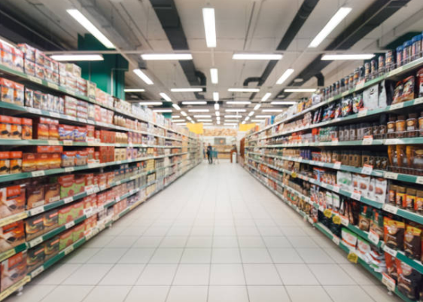




Trivial Solution
Supermarket
Kitchen
Requires extremely expensive data collection process and
does not generalize well to new environments or unseen contents
Living Room
Cafe
Notes:
So we would take measurements in supermarket, kitchen, living room, and café. After collecting all of these measurements for both fake and authentic alcohol, we can take them and feed them to a classifier [pause 0.5sec], and it [playful] might have a good accuracy. [click]
The problem of this approach is that even if it [stress] might work, it requires an extremely expensive data collection process and it does not generalize well to new environments or unseen contents. [click next slide]

Slide 20
Ideally: Synthetically Generate Measurements from Unseen
Environments
Apply different environments
Authentic
Authentic
Notes:
Ideally, we’d like to synthetically generate measurements from unseen environments.
[click]
So, let us say we take a measurement of authentic alcohol. [We have an operator that allows us to apply different environments [click] and use them in training the classifier.
[2s]
In order to do this, let me give you a quick background [click next slide]

Slide 21
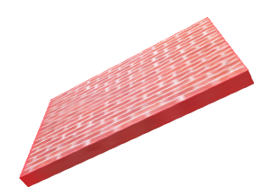
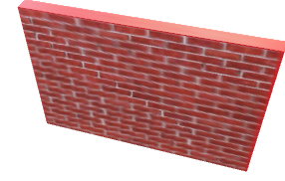
Decomposing the RFID Channel
Coupling effect
Multipath effect
C(ε)
M
Notes:
on how we can decompose the RFID channel. [0.5s]
There are two factors that impact the RFID’s measured signal. [click] The first arises from the interaction between the RFID and the dielectric content. We call this the coupling effect and denoted by C as a function of epsilon. [click] The second arises from the propagation characteristics and the reflections. We call this the multipath effect and denote it by M. [click next slide]

Slide 22
Decomposing the RFID Channel
Coupling effect
Multipath effect
H =
C(ε)
×
M
How can we isolate “M” to generate different environments?
Notes:
And the overall channel measurement that RFID reader obtains, H, is going to be a multiplication of C by M.
So, applying different environments means that we need to generate different M’s. [click] But, how can we isolate the multipath effect in the first place in order to generate different environments? [1s] The challenge here is that any measurement we take will be impacted by both coupling and the multipath effect. [click next slide]

Slide 23
Multipath Kernel Allows Generating
Environment-only Features
Authentic
Alcohol
H₁
Environment-only Features
Authentic
Alcohol
H_{LoS}
Notes:
To overcome this problem, they introduced a multipath kernel function that allows us to generate environment-only features. [1s] Let me explain to you how it works. [click]
Let us go back to the experiment where they extracted features from authentic alcohol in two different environments: the supermarket style setup and a relatively isolated setup.
Remember that we got two different feature vectors from these measurements. Let me call them H1 in red for the top setup, and HLOS in white for the bottom setup. [click] The multipath kernel simply divides these two measurements to generate environment-only features. [1s] To see why this is true [click next slide]

Slide 24
Multipath Kernel Allows Generating
Environment-only Features
Authentic
Alcohol
Multipath Kernel Function
H₁
C (ε) × M₁
M₁
=
=
Authentic
Alcohol
C (ε) × M_{LoS}
M_{LoS}
H_{LoS}
Independent of content
Notes:
Let us substitute each channel H by the product of coupling and the multipath. Since both bottles have authentic alcohol, they would have the same content, and the C component will cancel out.
[click] As a result, the output of the multipath kernel is independent of the content and only dependent on the surrounding environment. [1s]
Great. [click next slide]

Slide 25
Multipath Kernel Allows Generating
Environment-only Features
M₁
Generative model
M₁’
M_{LoS}
M_{LoS}
Measured real-world Environments
Unseen Synthetic Environments
Notes:
So now what we want to do is to come up with a model [click] or technique that can utilize these Environment Specific FEATURES to generate new environments.
And from here onwards, I pass it to Arun to explain the generative model and the results of it.

Slide 26
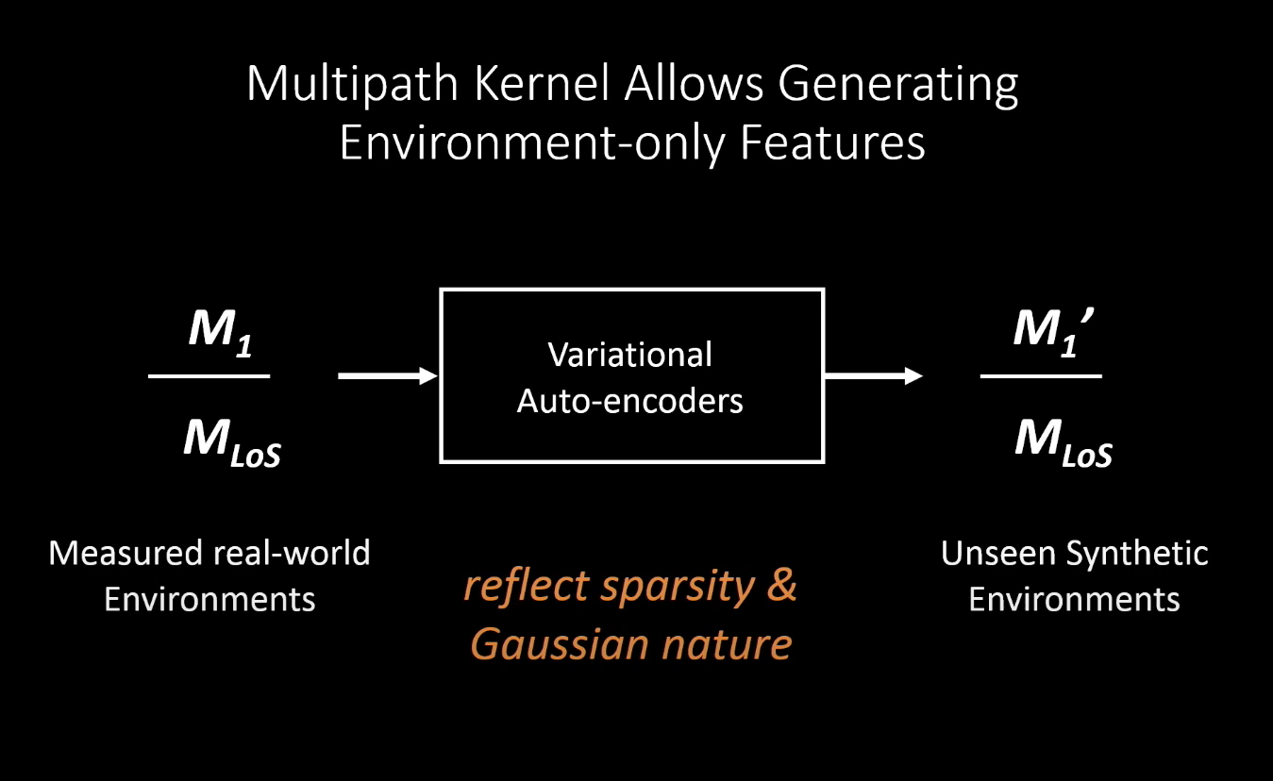
Notes:
VAE is a generative model-it estimates the underlying distribution of the training data. From neural net point of view, it has an encoder , decoder and a loss function. It can reflect sparsity of the environment and gaussian nature of wireless channels.

Slide 27
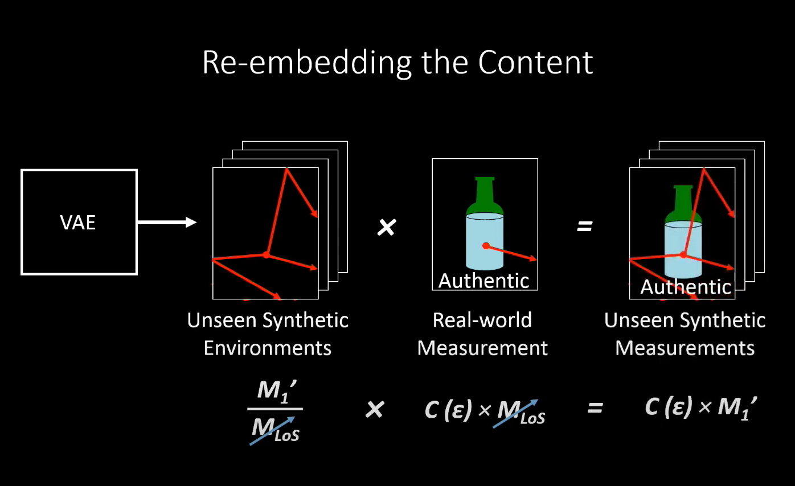
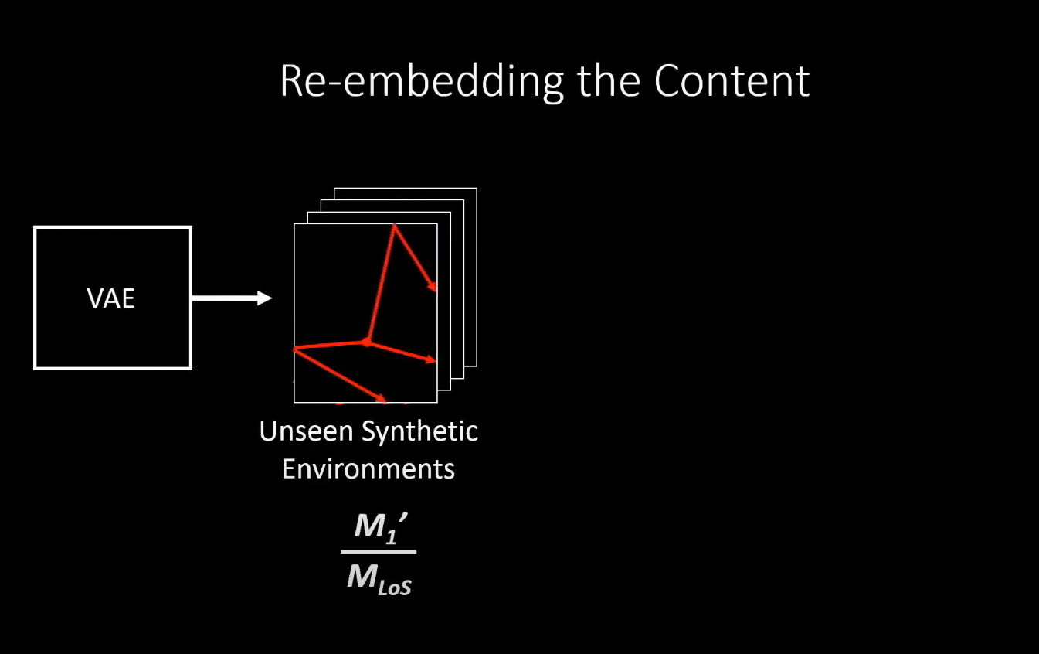
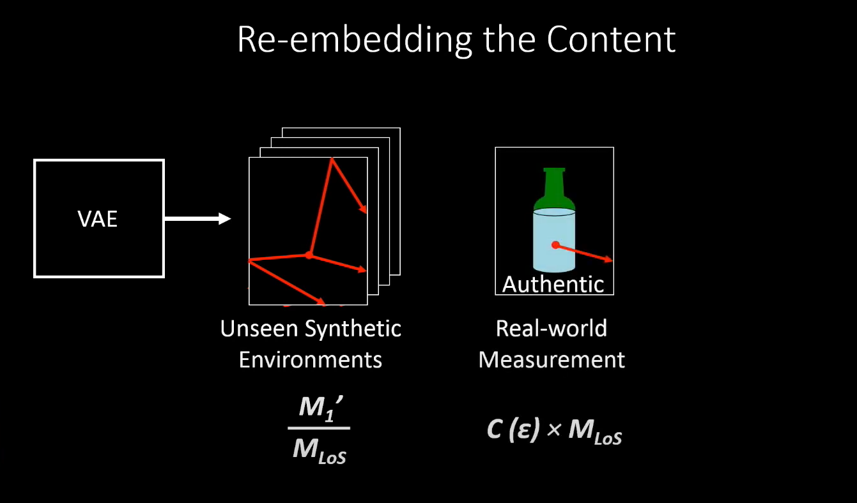
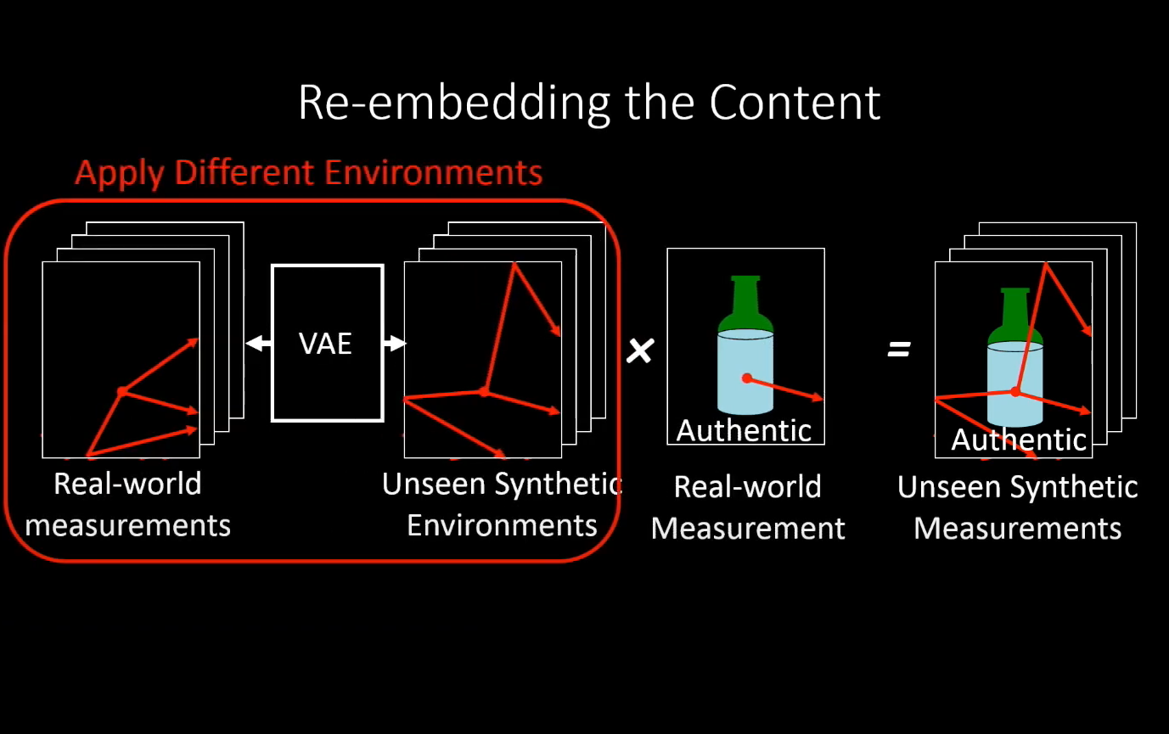
Notes:
Here,we use VAE’s to measure real world environments to generate unseen synthetic environments.The problem is that we cannot use the features directly to train the classifier because there are no content features here.No fake or authentic features,just the features of the environment.To solve this we re-embedd the content feature.Multiply along with single real world measurement to generate unseen authentic synthetic measurements.By doing this we can apply different environments.

Slide 28
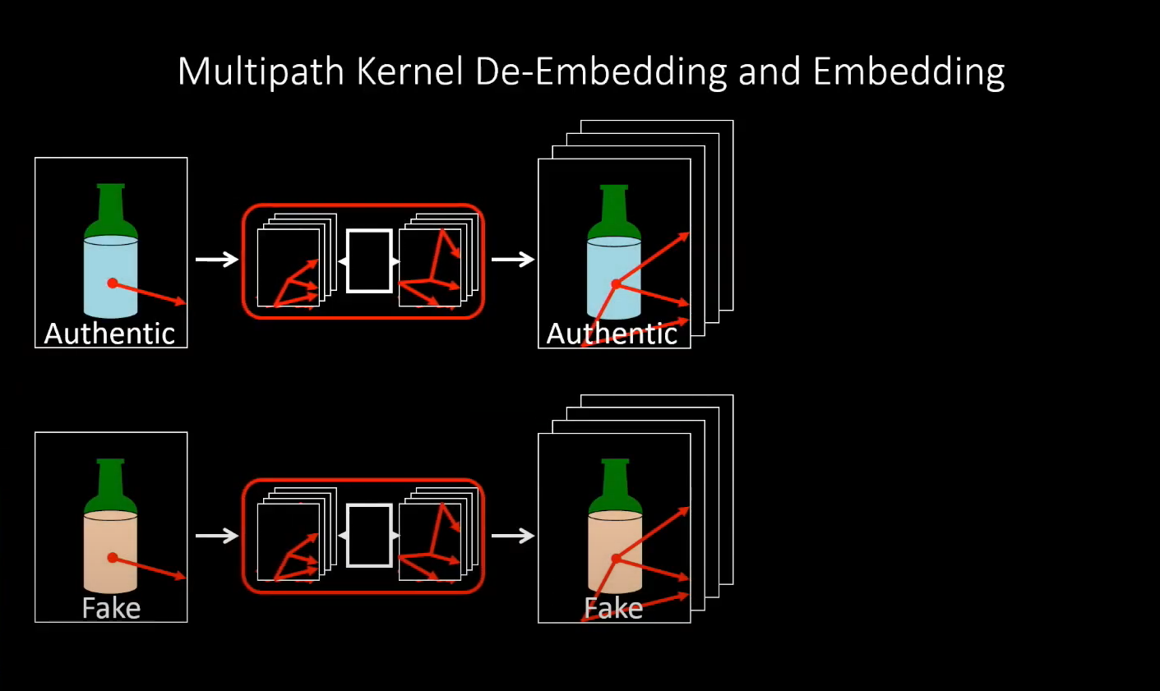
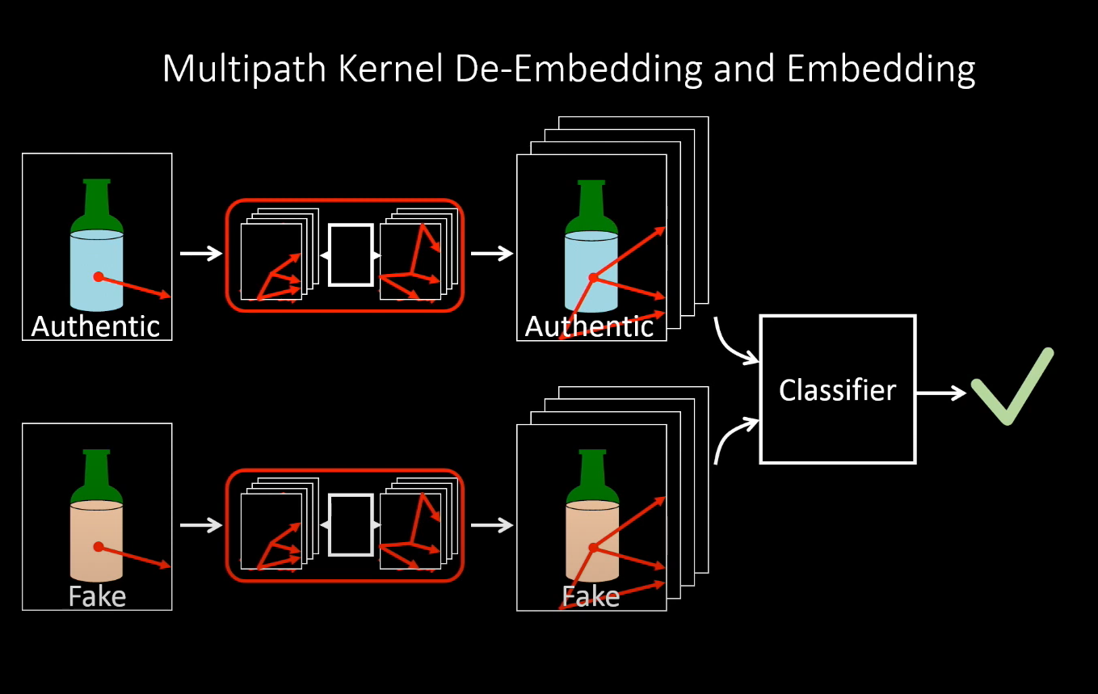
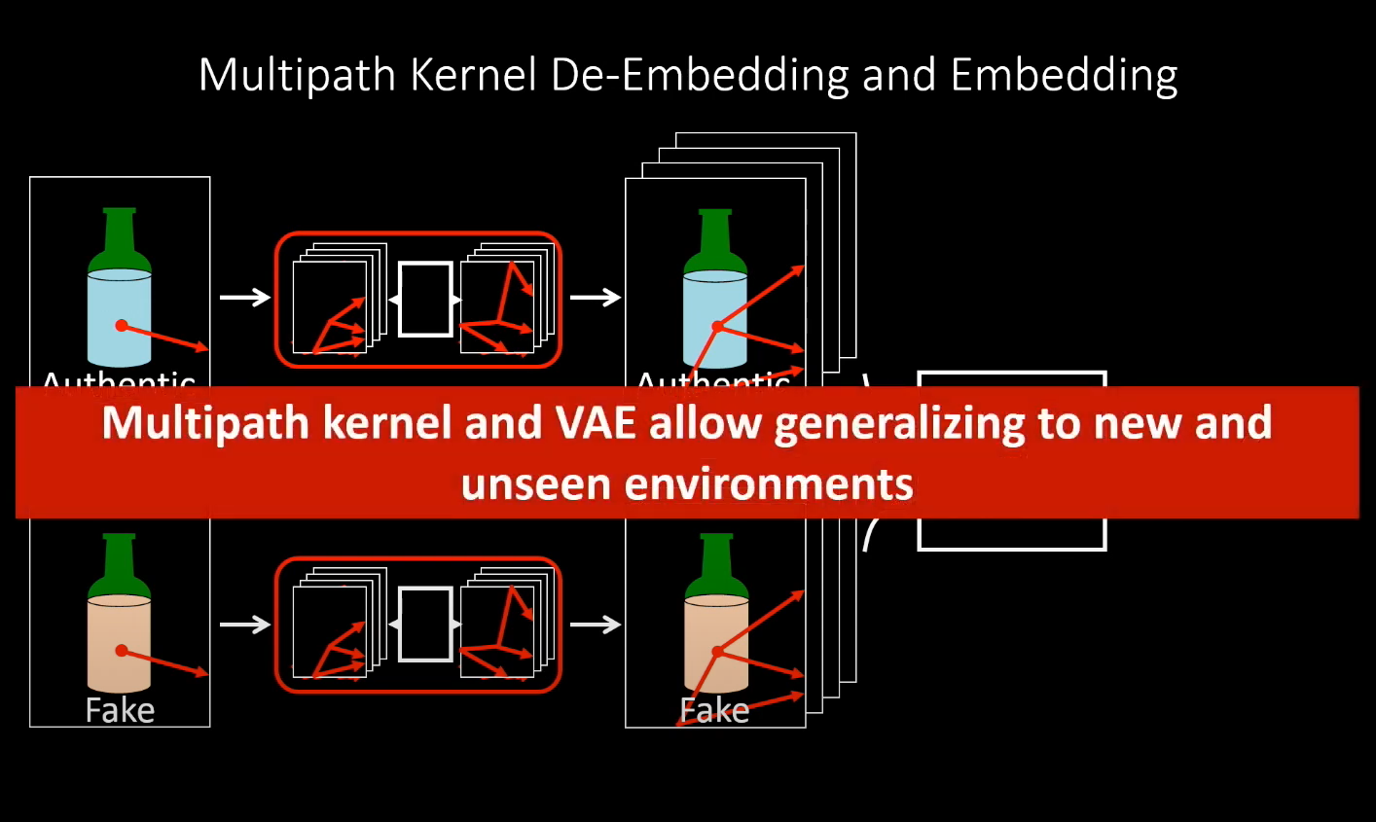
Notes:
We can do the same for fake alcohol.These synthetic data aloows us to train the classifier and say whether its real or fake contents in unseen environments.The key aspect here is that Multipath kernel and VAE allows us to gerenalize for new and unseen environments.

Slide 29
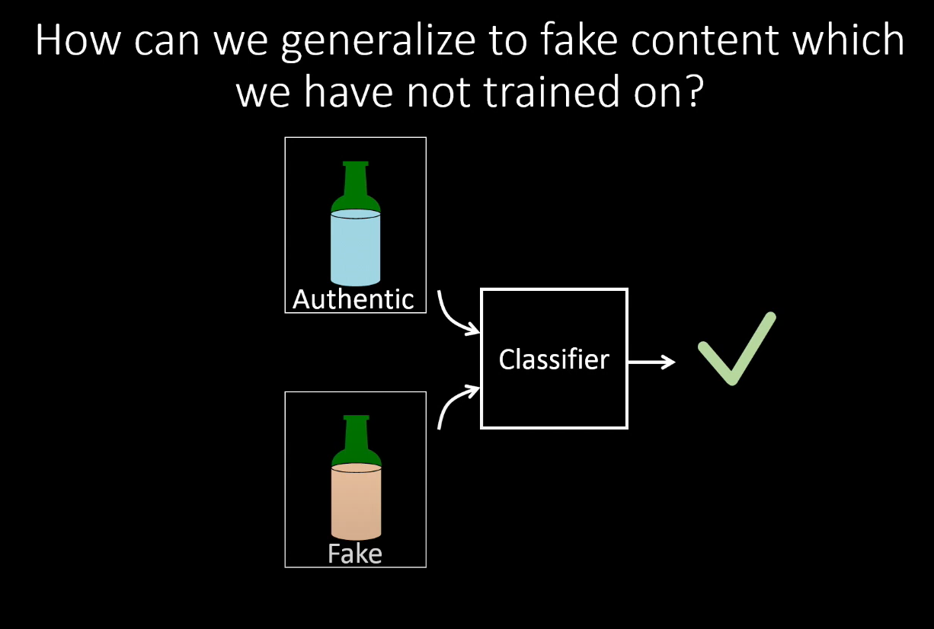
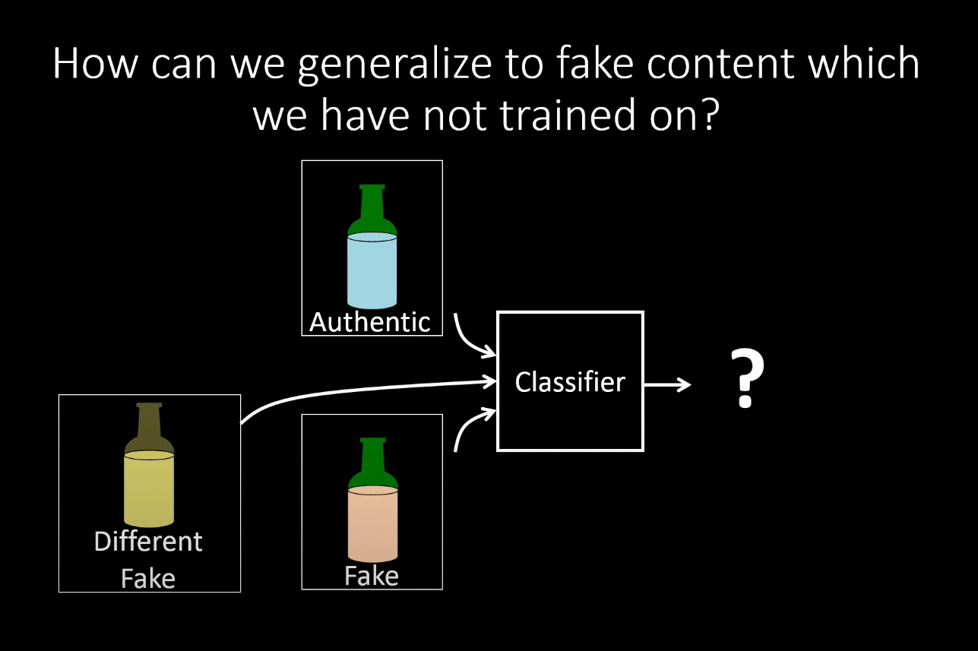
Notes:
We still have a question? Read from slide.So far we assumed that we know the authentic and fake one is.In most of the times,we cant identify the fake one.Id different fake one is fed to the classifier,It might not perform well at all.

Slide 30
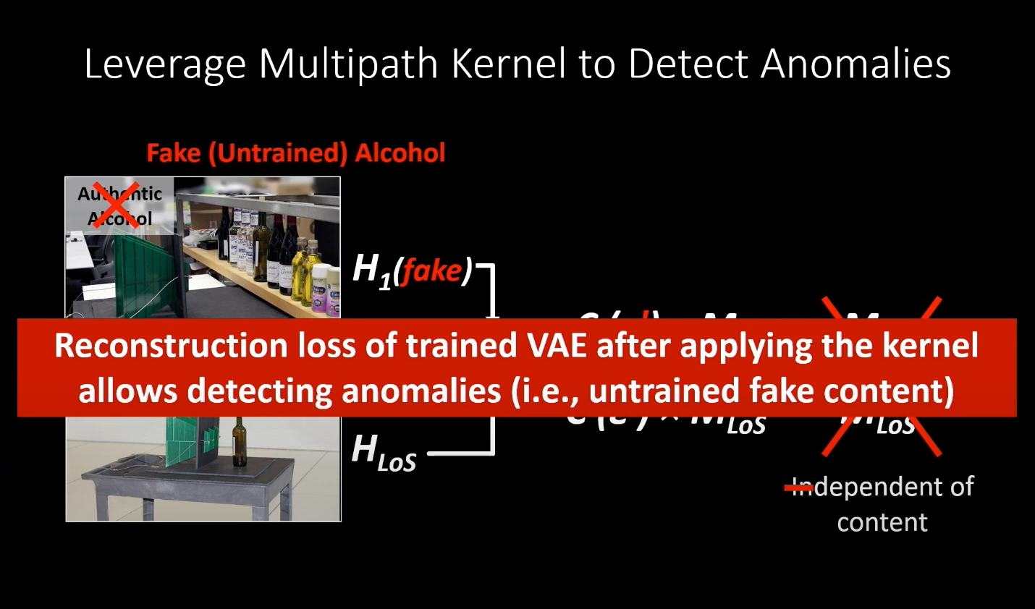
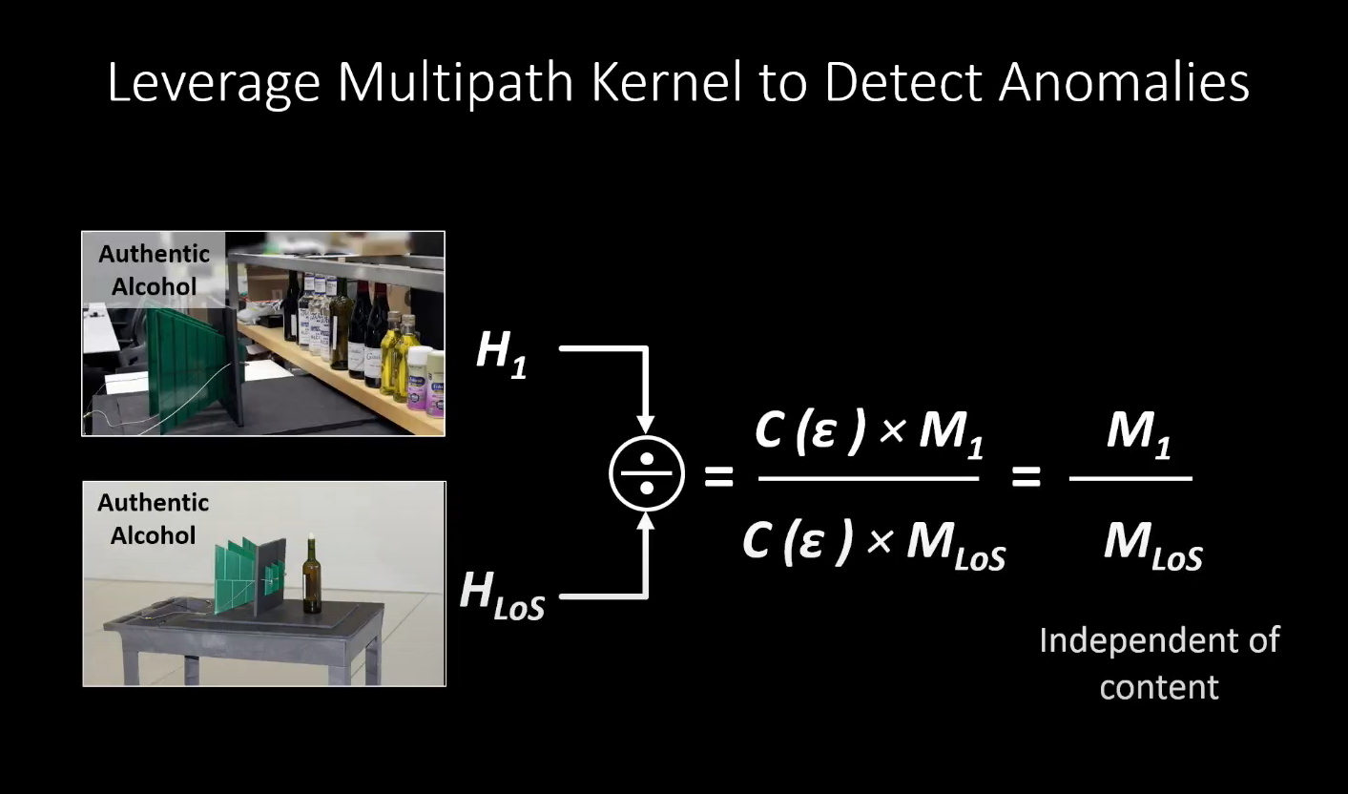
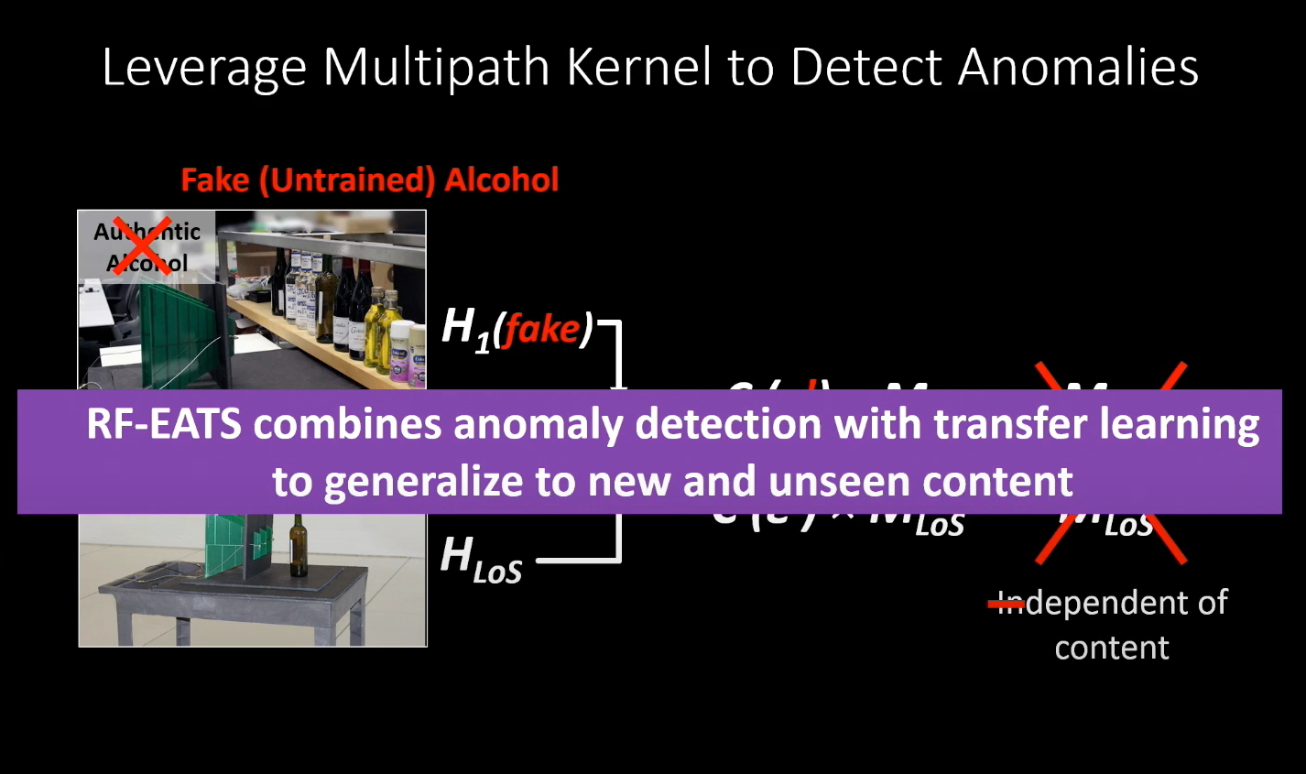
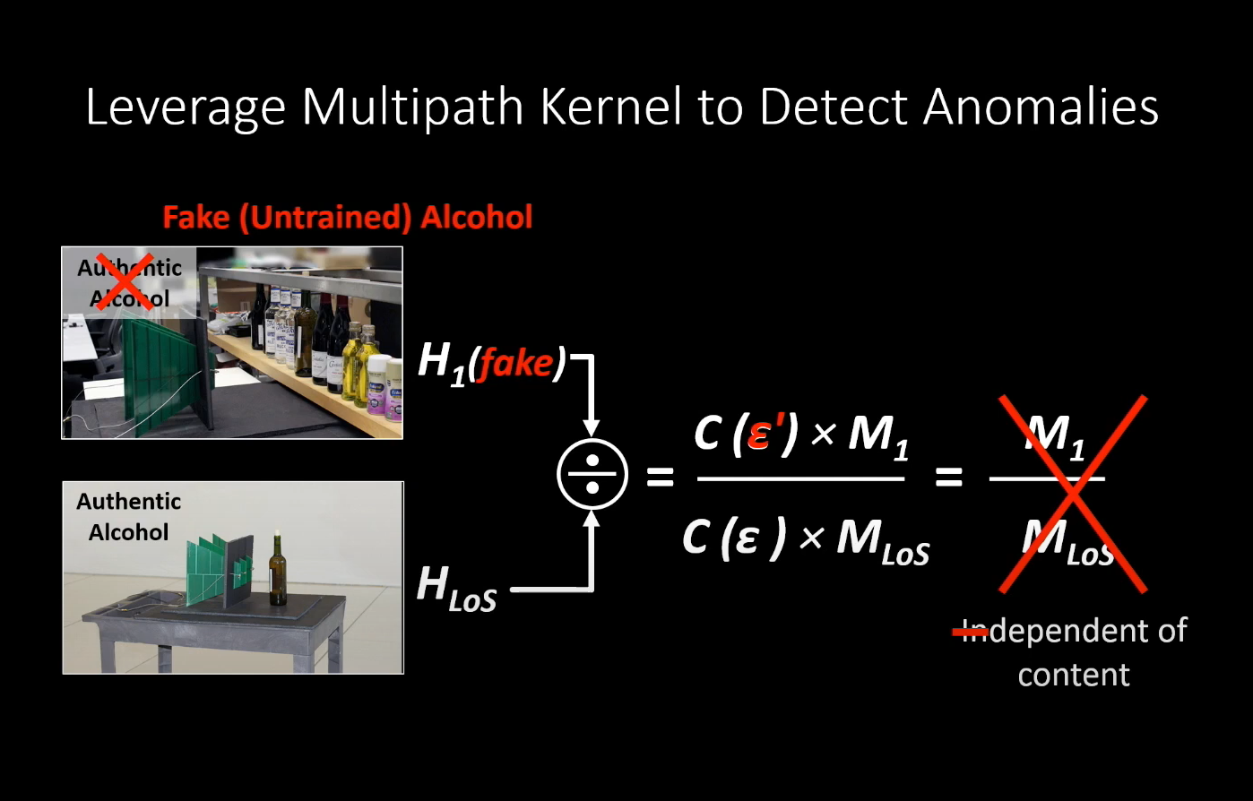
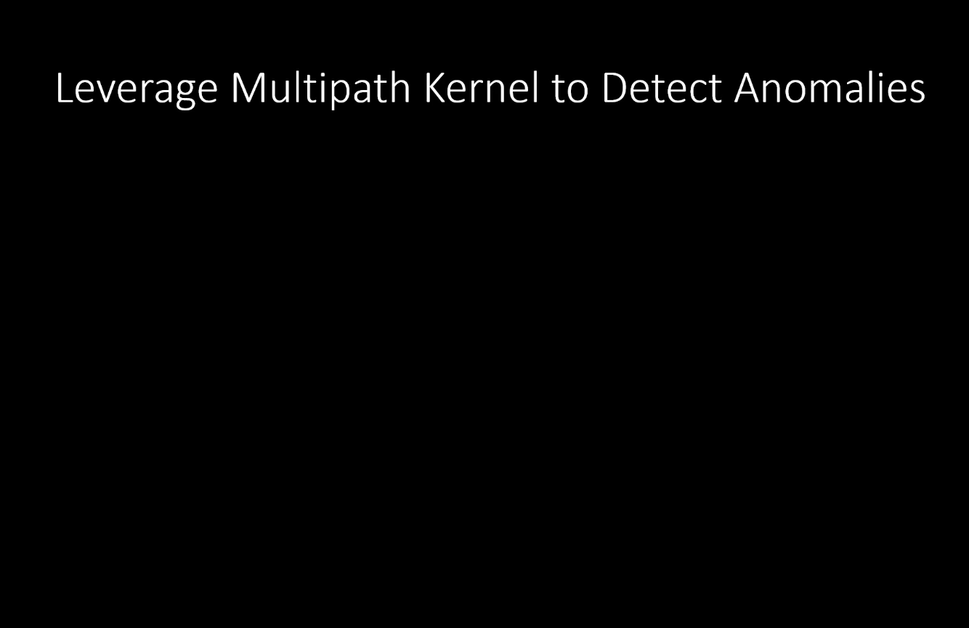
Notes:
To solve this,we leverage the same Multipath kernel effect which Usama went about in the beginning to detect anomalies. Remember that multipath kernel divides measurements in multipath environments by measurements in line of sight environments.If we take measurement from fake untrained alcohol,the response would be different.The coupling effect would be different ue to different liquid and won’t cancel out.The o/p feature is dependent on the content.In high level,by using reconstruction loss of trained VAE after applying kernel allows detecting anomalies.(ie we can separate b/w authentic and anomaly.
RF-eats combines anomaly with transfer earning to generalize to new and unseen content

Slide 31
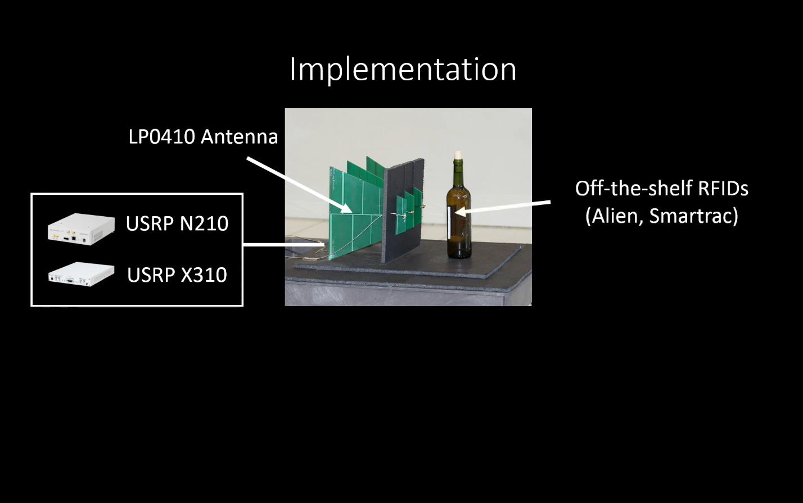
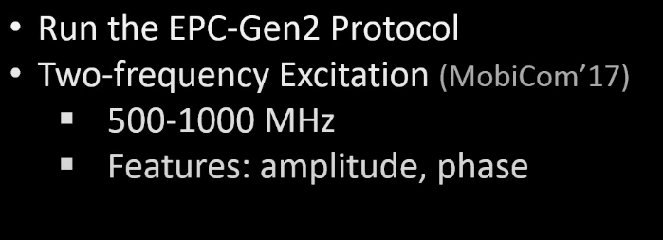
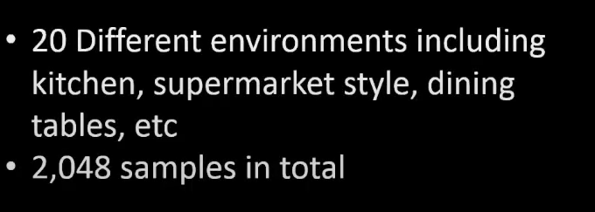
Notes:
Prototype implementation
RFID antenna:LP0410 antenna
Connected to usrps n210 and x310.We use off the shelf RFID on the bottles.
We use EPC-Gen2 protocol and follow two freq excitation for 500-1000 Mhz to extract features such as amplitude and phase

Slide 32
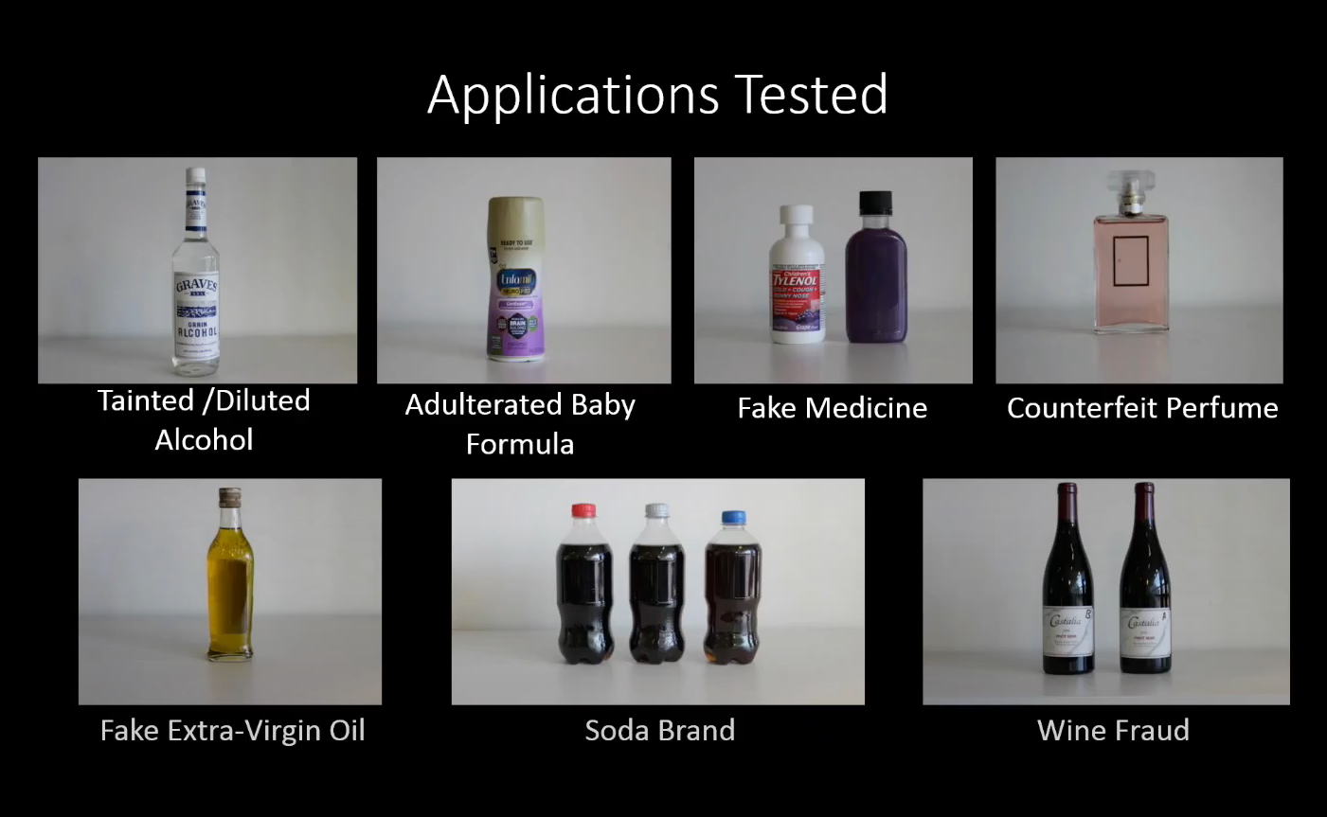

Slide 33
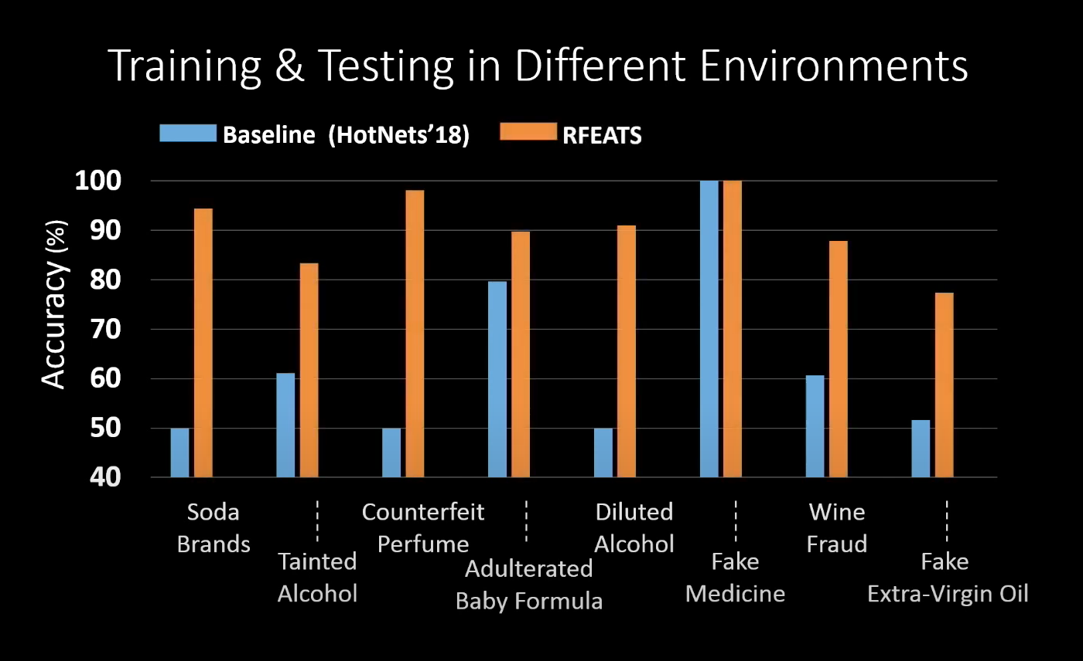
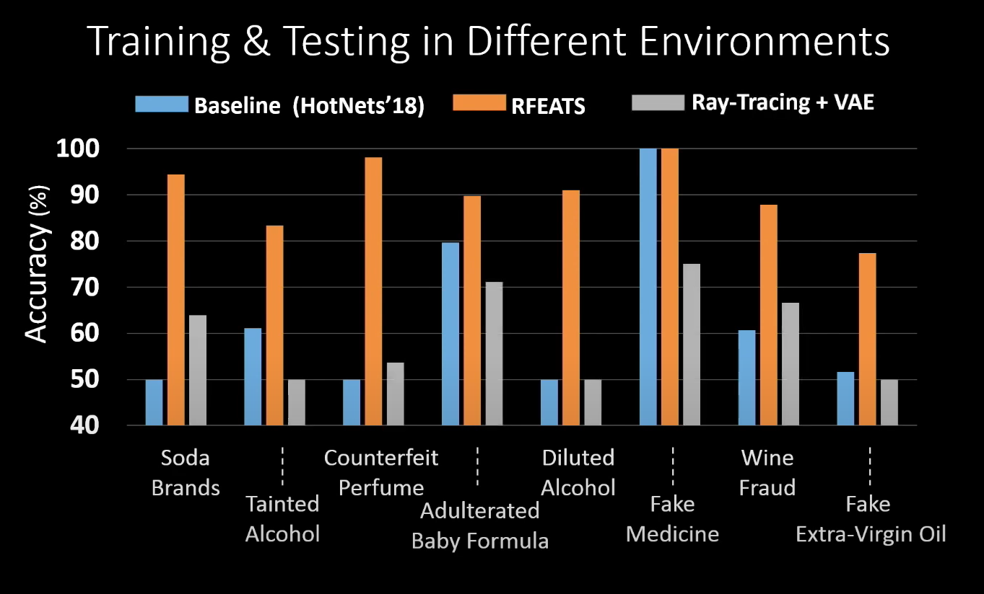
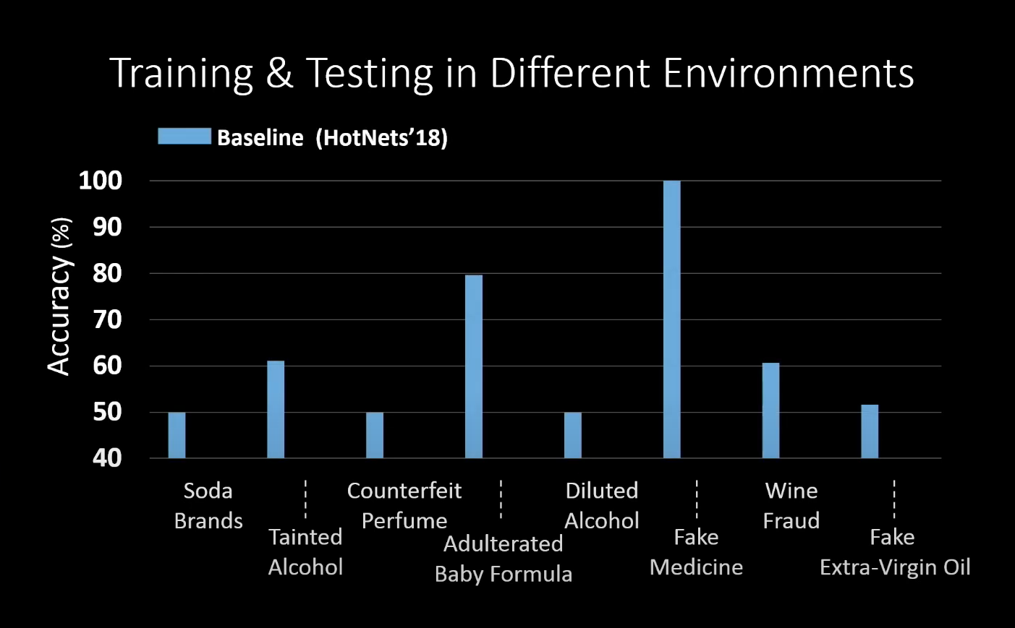
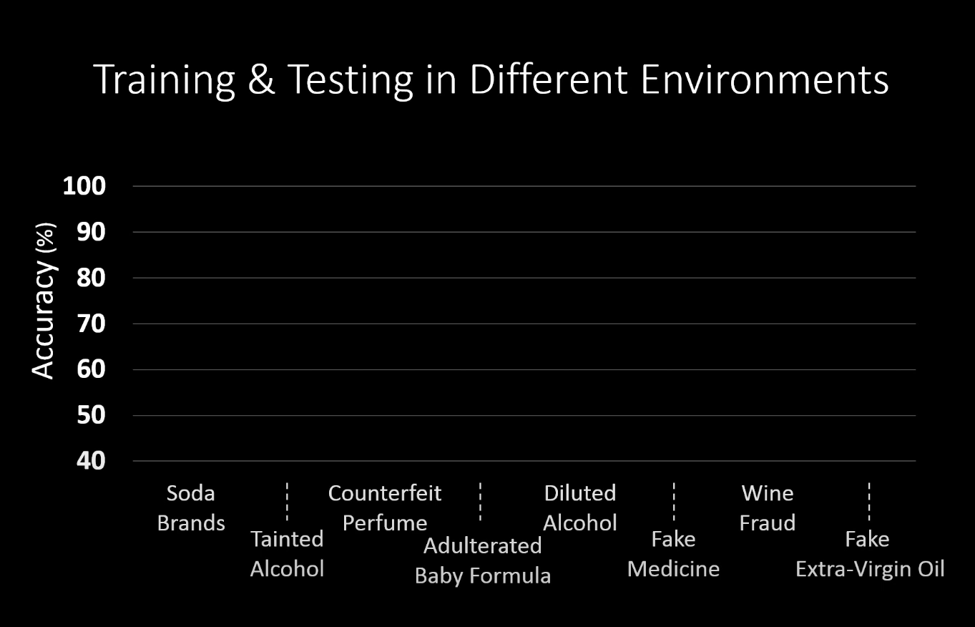
Notes:
Classification accuracy of materials tested on different environments. Baseline model accuracy was around 50-80 % coz it worked well for materials in the same training and testing environment.RFEATS accuracy is much high.Usually around 90%.ray tracing model with VAE,it performs worse that baseline.

Slide 34
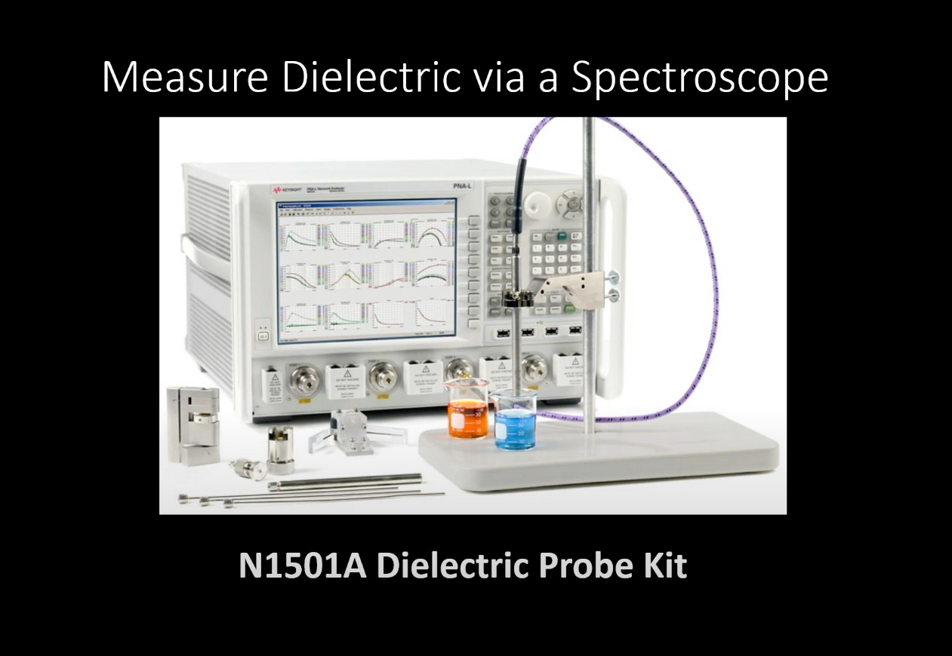
Notes:
Rfeats is impacted by Dielectric difference which is measured with the help of N1501A dielectric probe kit

Slide 35
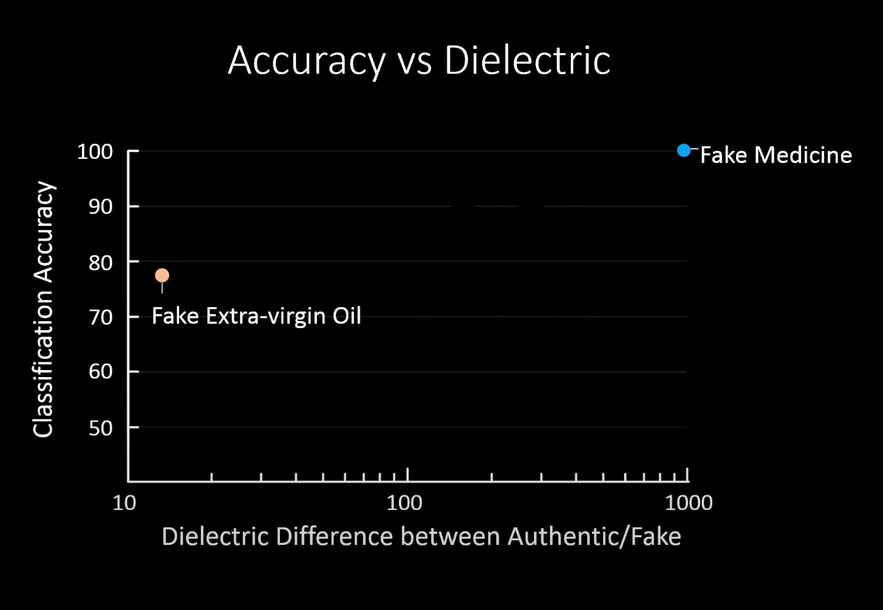
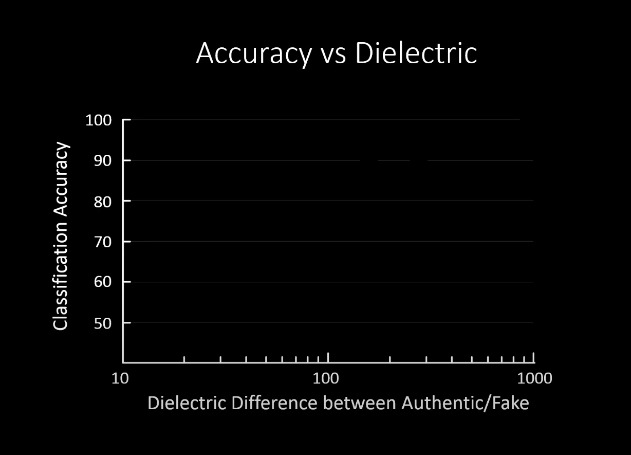
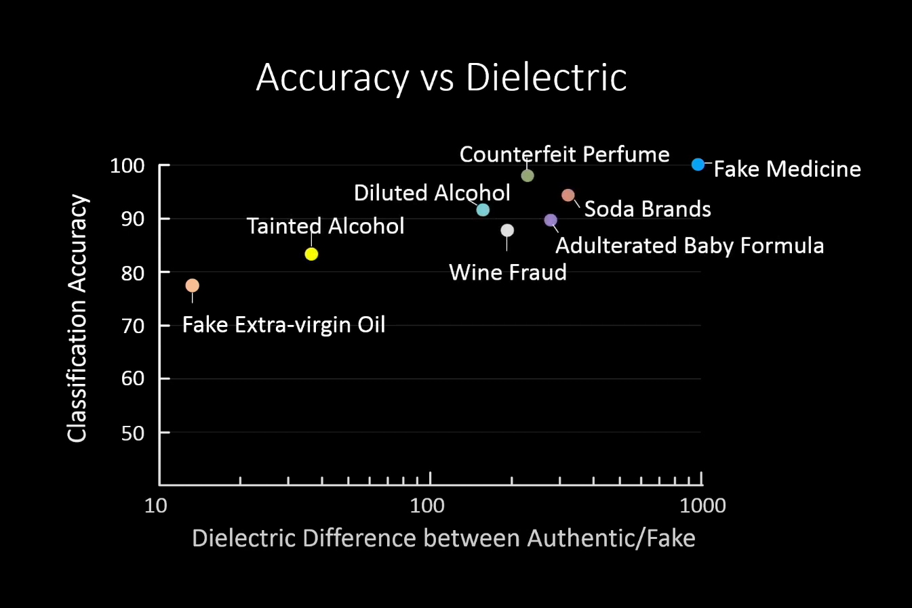
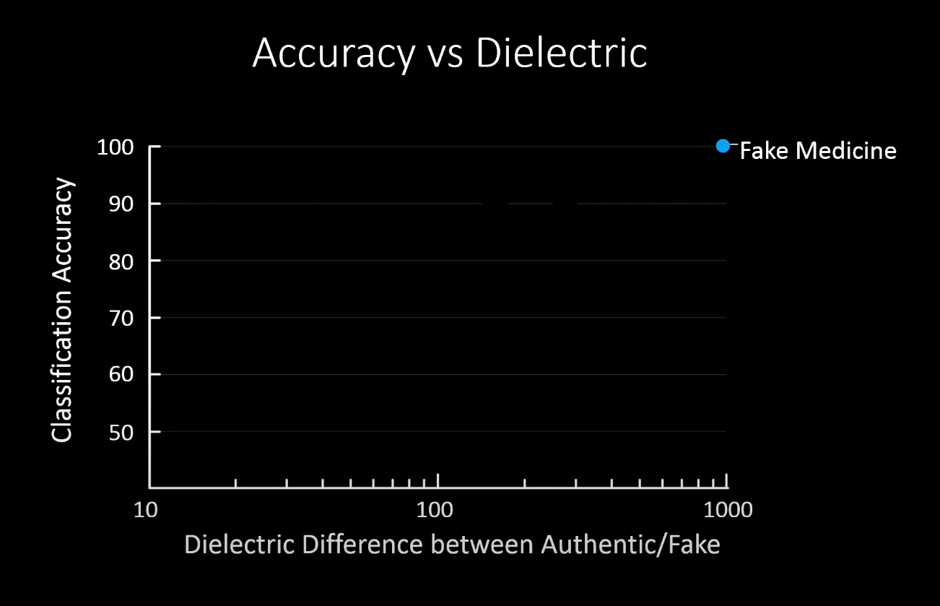
Notes:
Fake medicine had the highest accuracy due to leagest dielectric difference and fake extra virgin olive oil has the lowest accuracy.We could say that lower the dieectric difference ,lower the classification accuracy.

Slide 36
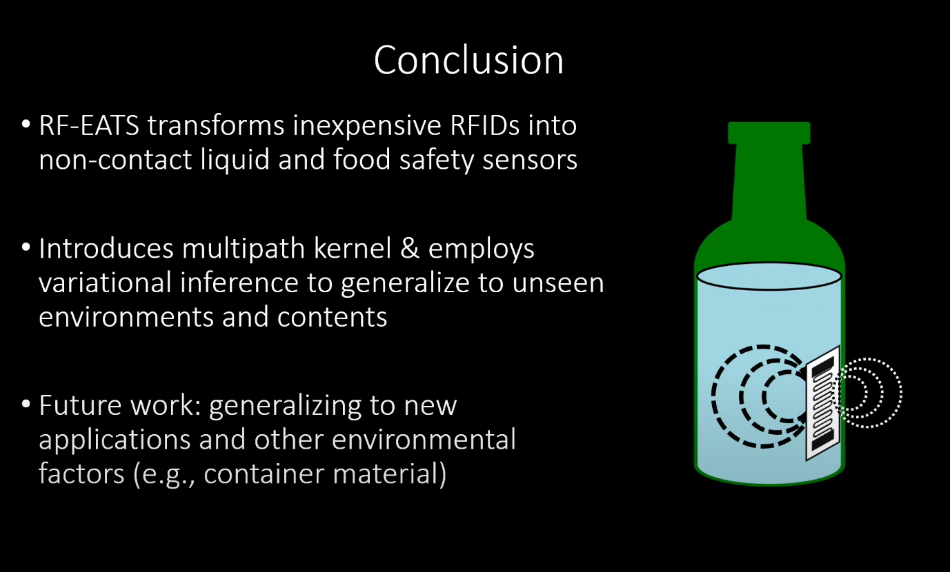

Slide 37
Our Insights
Form factor of the hardware is large.
Measurement of latent dielectric constant
Limited to certain packaging material of the container.

Slide 38
Thanks
Any Questions?

Slide 39
Extra Slides

Slide 40
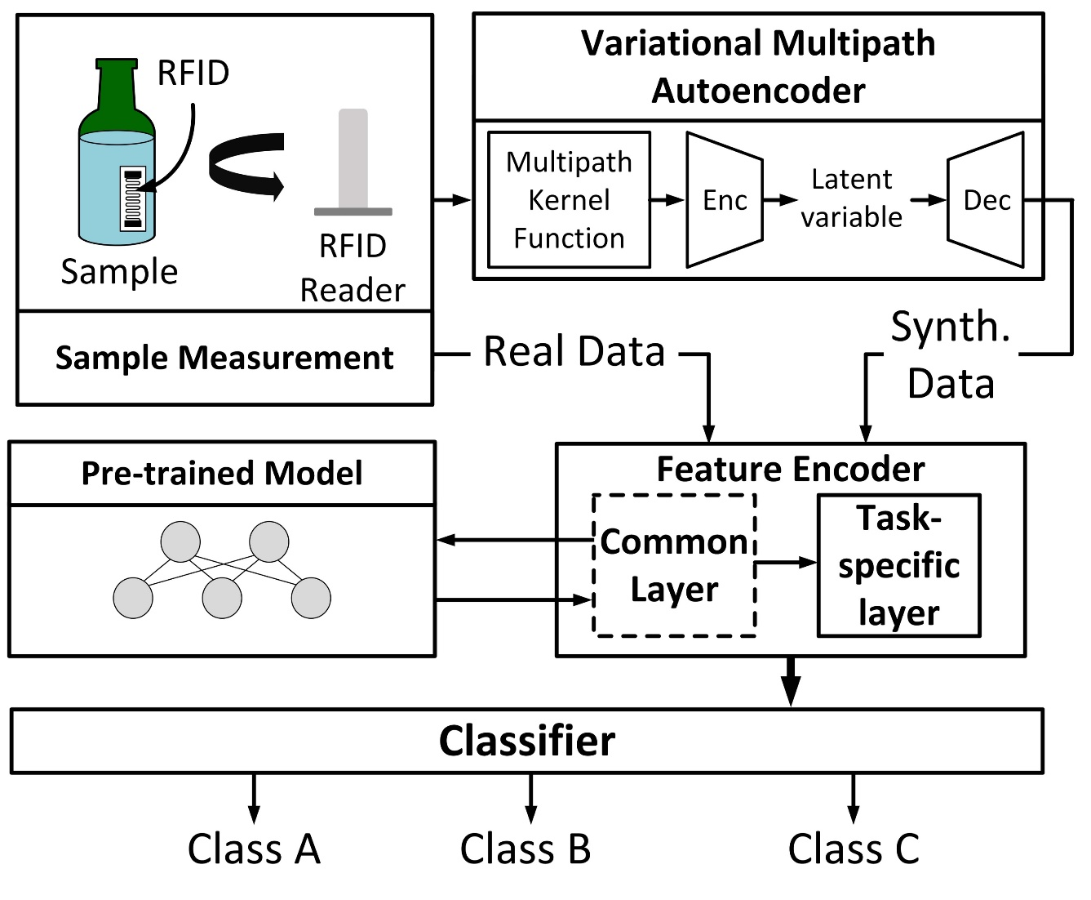
System Architecture
RFID Reader
Multipath VAE
Downstream Model

Slide 41
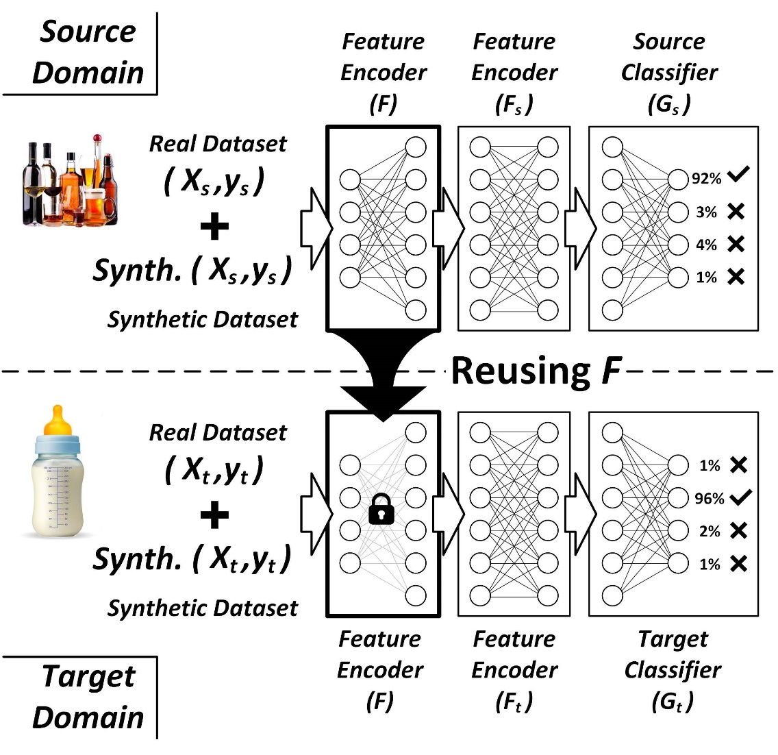
Transfer Learning Model
Shared Layers
Task specific classifiers

Slide 42
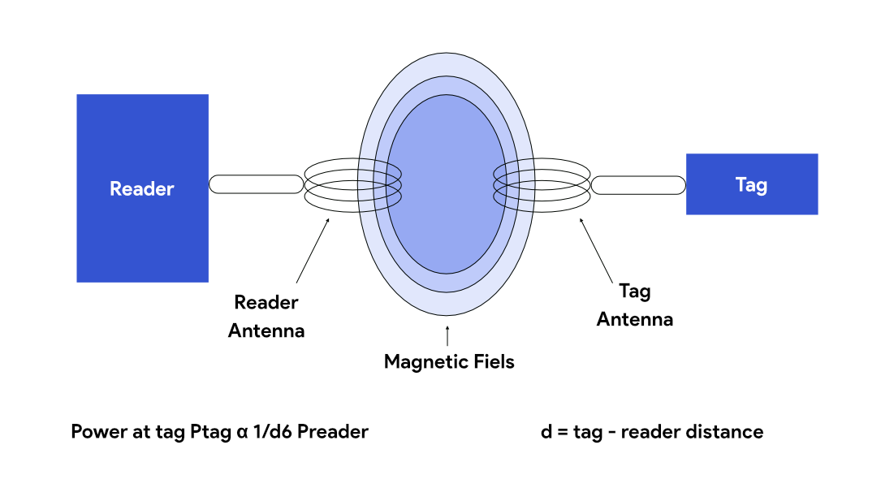
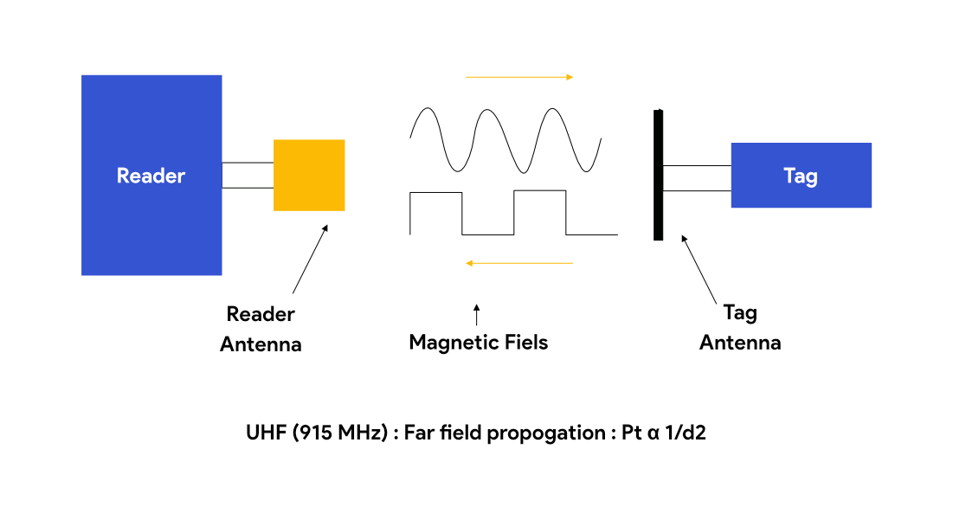
RFID - Coupling Techniques
Near Field (Inductive Coupling)
Far Field (Backscattering)
Notes:
When electromagnetic waves encounter an object that has a dimension of half the wavelength or more, it gets reflected. The efficiency with which an object reflects electromagnetic waves is described by its reflection cross-section

Slide 43
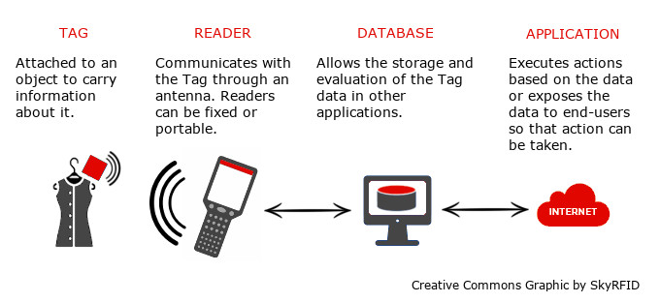
EPC – Gen 2 Working Principle (UHF RFID)

